Slide 1
Data Center Infrastructure CT109-3-2&Version 2
Electrical Power Systems I & II

Slide 2
Topic & Structure of The Lesson
Electrical Power Systems I & II

Slide 3
Learning Outcomes
At the end of this topic, YOU should be able to:
Understand AC and DC power solutions.
Identify the various types of UPS including scalable & modular designs for energy efficiency and eco-mode operation.
Explain standby/backup power and understand emerging technologies in this area – including fuel cell technologies.
Be aware of the codes and regulations covering electrical installation.
Managing UPS capacity throughout the lifecycle of the data centre.
Maintenance considerations.

Slide 4
Key Terms You Must Be Able To Use
If you have mastered this topic, you should be able to use the following terms correctly in your assignments and exams:
UPS
PDU
RPP
RPS

Slide 5
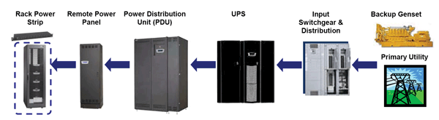
Typical Data Center Power Distribution System

Slide 6
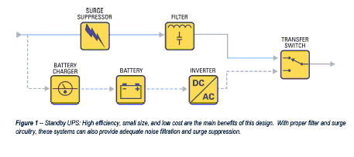
Types of UPS
Standby

Slide 7
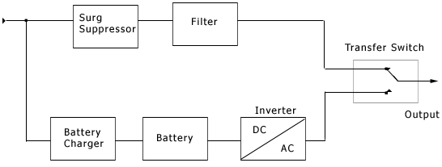
Line Interactive UPS

Slide 8
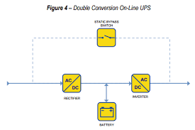
Online UPS

Slide 9
Utility Power and Transformer
Power from the electric utility is usually delivered at voltages anywhere from 480V to 21 kV and higher. The first step in the distribution process is to transform this voltage to a level that is usable by the building and datacenter equipment.
In many parts of the world, a single transformer reduces medium voltage from the utility to 400/230V, with 230 the final voltage supplied to datacenter equipment.
Switchgear Datacenters use switchgear and distribution boards to safely distribute power from the utility to the datacenter floor. The switchgear includes circuit breakers and switches for managing medium and low voltages and they are typically used to distribute large amounts of power to various locations within datacenters and buildings.
The purpose of the breakers is to interrupt and disconnect the load from the power source in the event of abnormally high current conditions that could damage the electrical system or create unsafe operating conditions

Slide 10
Power distribution units (PDUs) typically consist of multiple distribution panel boards and can also include internal transformers. (PDUs without transformers are typically called remote power panels (RPPs). PDUs tend to have a significant amount of built-in intelligence and monitoring capabilities.
Rack Power Distribution
Inside each rack is a power strip or rack-mounted power distribution unit (rPDU) that distributes power to the IT equipment installed in the rack.

Slide 11
Quick Review Question
Briefly explain various types of UPS.
Explain the typical data center power distribution system.

Slide 12
Summary of Main Teaching Points
Discussed AC and DC power solutions and identified the various types of UPS including scalable & modular designs for energy efficiency and eco-mode operation.
Also discussed standby/backup power technologies.

Slide 13
Question and Answer Session
Q & A

Slide 14
What we will cover next
Room Layout

